Slide 1
PERT

Slide 2

PERT
Program Evaluation and Review Technique
This time the durations are probabilistic
Very similar to CPM, however because the durations are probabilistic, we have a situation where when find the time or duration for a project, it means that there is a 50% chance or probability of 0.5 of finishing the project by that time.

Slide 3
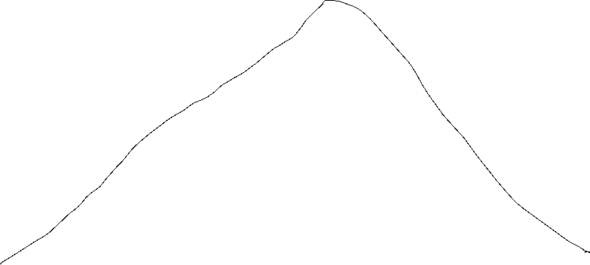



Slide 4




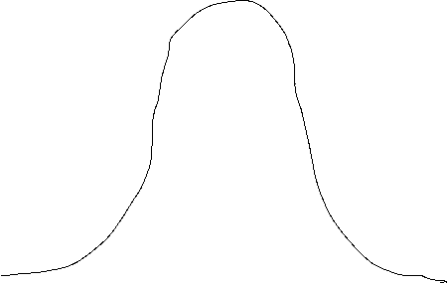


Slide 5
So, in order to use the PERT technique, you need to make 3 guesses as to what the duration will be for each activity in your project.
The first guess is the optimistic guess. A 20mins
The second guess is the most-likely guess. M 30mins
The third guess is the pessimistic guess. B 1hour

Slide 6

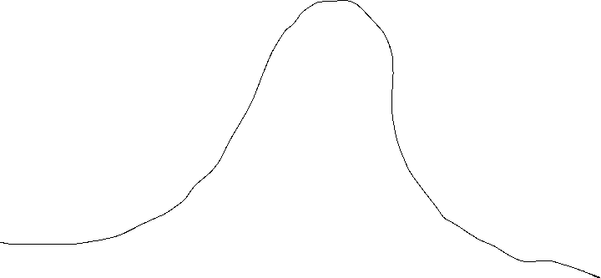
















Slide 7







Slide 8








Slide 9
















Slide 10



















Slide 11
















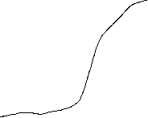






Slide 12




Slide 13



















